Slide 1
ETHEREUM HISTORICAL DATA REPORT
K.S.ABISHEK
September 11, 2022

Slide 2

Introduction - Data Profiles
Dataset contains data values of high, low, open and close for a period of 2381 days , that is , 6.52 years (or) 78 months and 6 days , beginning from 3rd March 2016 up to 15th September 2022.
Dataset is highly cardinal , unique and highly co-related

Slide 3

QUICK INSIGHTS

Slide 4
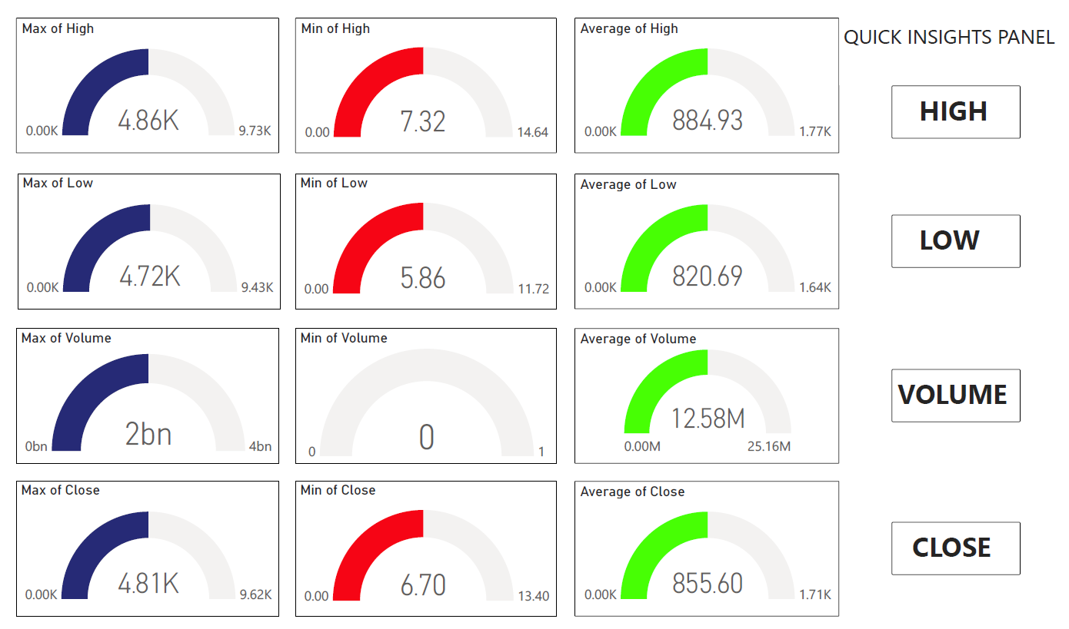
MAX,MIN & AVERAGE OF STOCK PARAMETERS

Slide 5
IMPORTANT TRENDS
Lowest recorded value of open was 6.68 USD on 6th December 2016
Highest recorded value of open was 4808.34 USD on 9th November 2021
Lowest recorded value of close was 6.7 USD on 5th December 2016
Highest recorded value of close was 4808.34 USD on 8th November 2021
Lowest recorded value of high was 7.32 USD on 25th December 2016
Highest recorded value of high was 4864.06 USD on 10th November 2021
Lowest recorded value of low was 5.86 USD on 6th December 2016
Highest recorded value of low was 4715.43 USD on 9th November 2021
Lowest value of volume was 0 for 7 days from 3rd August 2016 to 9th August 2016. All parameters like high , low, volume and close remained unchanged during this period

Slide 6
TRENDSETTERS
The price of Ethereum began to see it’s first huge leap from the 25th of April 2017, when it’s closing price went from 53.9 USD to 68 USD just in two days
Within the next week , it’s price had increased to $82 , which is a massive 57.6% increase within a week
The value of Ethereum had peaked twice in two periods : PERIOD I AND PERIOD II

Slide 7
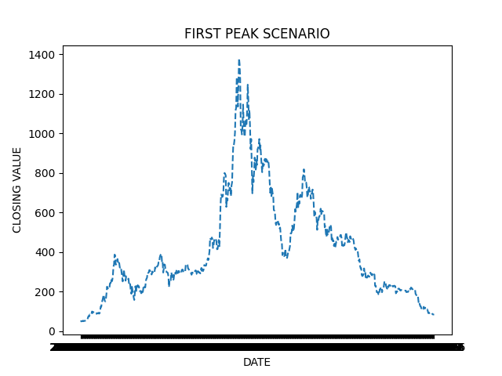
Period I (612 Days)
Period I had a timespan of 612 days , and the peak value was reached on the 274th day , wherein the peak value was 1380 USD on 13th January 2018. Period I spans from 14th April 2017 to 17th December 2018

Slide 8
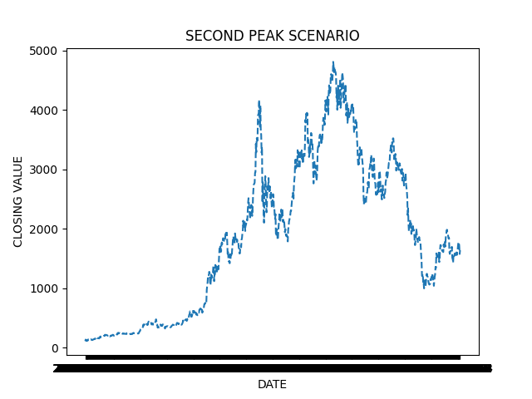
Period II (900+ Days)
24
This period is currently non terminal and under observation.
This period shows repeated trends in peak scenarios , and is hence being observed at the time of writing this report.
A peak value in closed is followed by two consequent dips in the closing value as shown
This period extends from 12-03-2020 up to 15 September 2022
The aforementioned trend may be exploited for future predictions
22
23
11

Slide 9
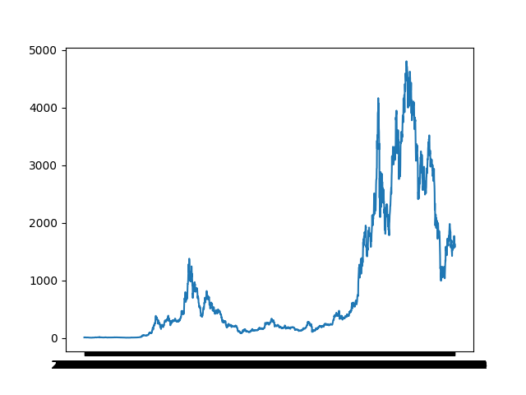
CLOSING VALUE vs YEARS
P2
This Graph represents the trends in closing value over the span of 1800+ days.
P1
2016
2022

